Slide 1

An Exploration of Data Exchange in Go
Golang Indianapolis Meetup
Nathan Boyd
Salesforce
github.com/nathan-boyd
Notes:
Microservices Platform Team
Focused on creating a modern platform and helping teams migrate to it
Write a lot of Go for our own use
Auth service
Generators
Web Hooks
Data Access Operator
Data Exchange
Simple topic
Lots of depth here
Something we do all of the time

Slide 2
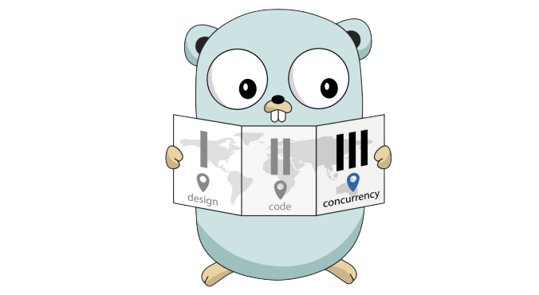
Go’s Values
Data Exchange - 1
Marshaling - 2
Custom Marshaling - 3

Slide 3
Data Exchange
SECTION ONE

Slide 4
What is Data Exchange
Data exchange is the transformation of data from one format into another.
Notes:
A common task for a software engineer is to transform data from one format into another that is suitable for their needs.
Some data formats are good for storage, others are easy to edit, and some are ideally suited for transport.
Transforming data from a source format and into a target format is known as Data Exchange.

Slide 5
Data Exchange - English Verbs
Encode: to convert from one system of communication into another
Marshal: to bring together and order in an appropriate or effective way
Serialize: to arrange or publish in serial form
Notes:
In Computer Science we have fancy words for simple ideas, and sometimes we have many fancy words for a single idea.
Such is the state of the words related to Data Exchange.
Encode, Marshal, and Serialize are common terms and in the most generally sense these words mean the same thing, to add or manipulate a logical structure.

Slide 6
Data Exchange - Computer Science Verbs
Encode: convert into a coded form
Marshal: the creation of a representation of data
Serialize: a marshaling process by which an object is converted into bytes for storage or transmission

Slide 7
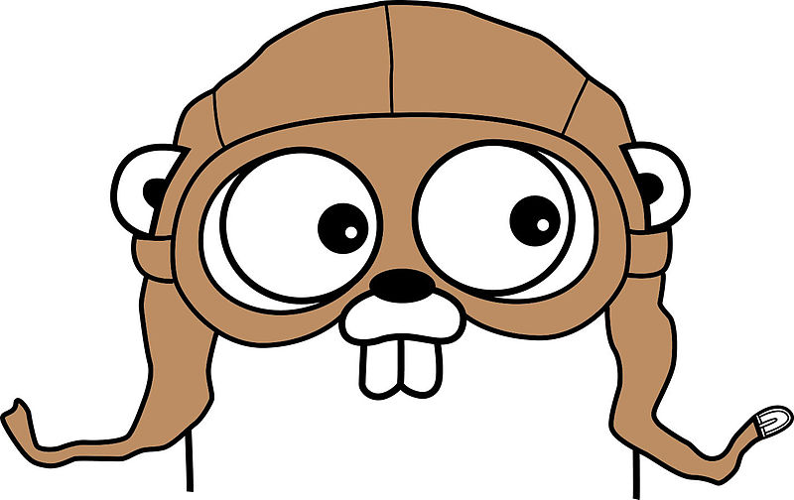
Data Exchange - GO Verbs
Encode: used when working with Go byte streams (unbounded)
Marshal: used when working with Go byte arrays or slices (bounded)
Notes:
In the Go standard library we use the terms Encoding and Marshaling for two distinct but similar ideas.
GO Encoders provide structure to streams while GO Marshalers provide structure to bytes in memory.
The key differentiator is that Encoders are for streams which are unbounded and Marshalers are for arrays of bytes which are bounded.

Slide 8




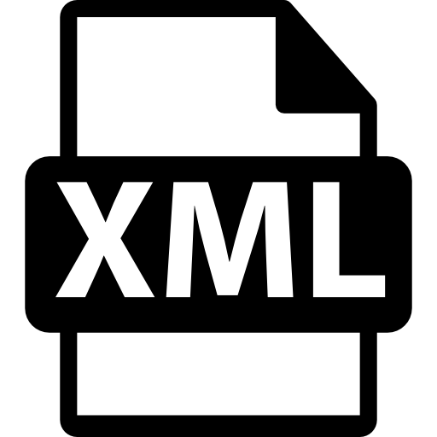

Data Exchange to bytes
Bytes
Notes:
There are many well known data formats that you may be familiar with.
YAML, XML, CSV, and JSON are popular text based human readable formats, binary formats like Protobufs and Flatbuffers are are gaining in popularity due to their improved serialization performance and small size when compared to text based formats.
The prevalence of JSON in our industry makes for an ideal format to focus our exploration.
JSON (JavaScript Object Notation) is a format that is easy for humans to read and write and it is easy for machines to parse and generate.

Slide 9
JSON Marshaling
SECTION ONE

Slide 10
JSON Marshaling and Unmarshaling
The Marshal function returns the JSON encoding of ‘v’
func Marshal(v interface{}) ([]byte, error)
The Unmarshal function parses the JSON-encoded data and stores the result in the value pointed to by v.
func Unmarshal(data []byte, v interface{}) error
Notes:
The encoding/json package provides a couple of functions to help us convert our objects to byte arrays and our byte arrays to objects

Slide 11
Custom JSON Marshaling
SECTION TWO

Slide 12

Custom JSON Marshaling With Struct Tags
Struct tags allow you to attach metadata to the field which can be read using reflection.
There are many well known tags, several of them are for marshaling.
type Cat struct {
Name string `json:"pet_name"`
Color string `json:"pet_color"`
}

Slide 13
Custom JSON Marshaling With Embedded Interfaces
Within the encoding/json package you’ll find the Marshaler and Unmarshaler interfaces. These may be implemented to perform encoding operations to suit your needs.
Notes:
Marshaling with struct tags is useful, but when we encode back to a serialized format we transform our cat’s “Name” back to to pet_name.
This may or may not be the behavior you’re looking for. What if we wish to maintain fidelity to our object’s field names and encode Name just as Name?
GO has a plan for that. Within the encoding/json package you’ll find the Marshaler and Unmarshaler interfaces which may be implemented by your structs to perform encoding operations to suit your needs. When the encoding/json package finds a type that implements the Marshaler / Unmarshal interface, it uses that type’s MarshalJSON() and UnMarshalJSON() functions instead of the built in functions to transform the object.
If you’re familiar with some object oriented languages you might think of method overriding. The end result is effect is similar but GO calls this practice embedding.

Slide 14
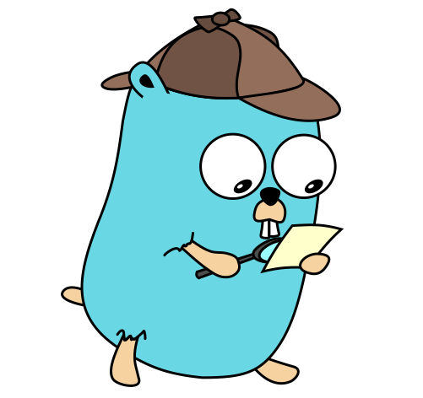
The Marshaler Interface
Marshaler is the interface implemented by types that can marshal themselves into valid JSON
type Marshaler interface {
MarshalJSON() ([]byte, error)
}

Slide 15
Custom JSON Marshaling With Embedded Interfaces
Go provides a Marshaler and Unmarshaler interface for most data exchange formats.
So if you’re working with YAML, XML, or Protobufs the same pattern will likely available.
Notes:
Let try it in our example project

Slide 16
Summing up
SECTION THREE

Slide 17
Takeaways
Encode - used when working with Go byte streams (unbounded)
Marshal - used when working with Go byte arrays (bounded)

Slide 18
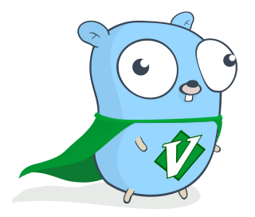
Takeaways
Struct Tags and Custom Marsherlers can be helpful for more complex transforms.

Slide 19
Takeaways
Go provides a Marshaler and Unmarshaler interface for most data exchange formats.
So if you’re working with JSON, YAML, XML, or Protobufs the same patterns will likely available.

Slide 20
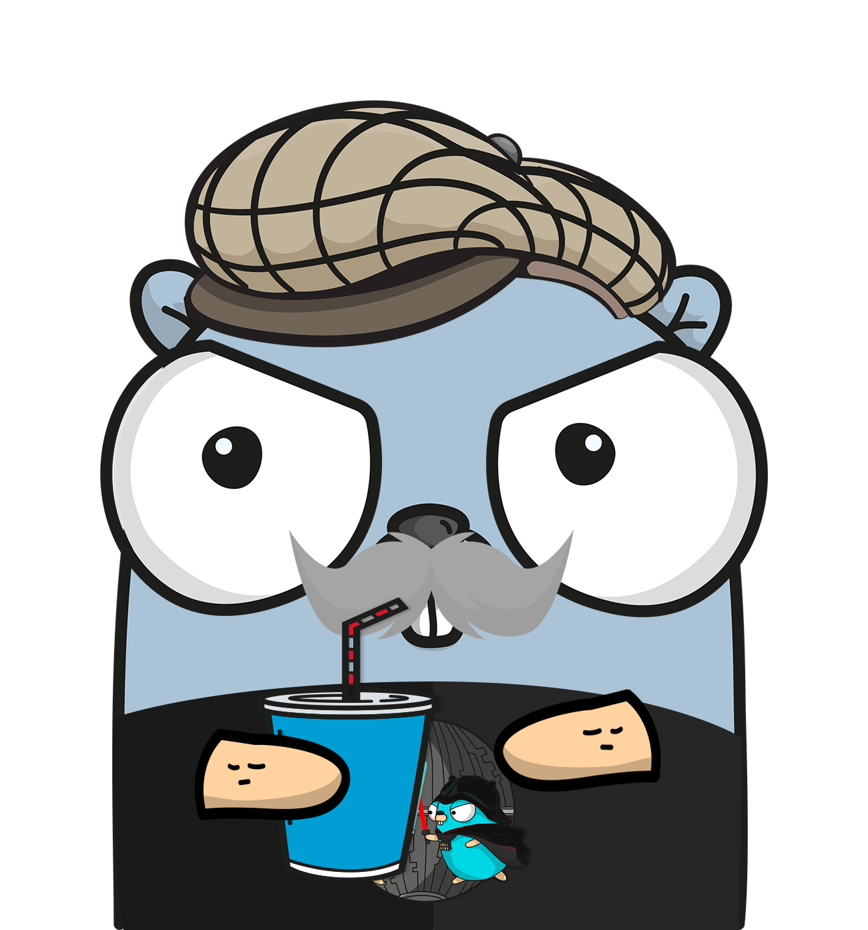
Resources
Playgrounds Based on the Demo
Marshaling
Unmarshaling
Unmarshaling JSON String
Embedding a custom Marshaler

Slide 21
Resources
Go Subclassing / Overriding via Embedding
Go Embedding
Tags in Go Struct types
Go Struct Tag Reference
Go well known Struct Tags
Gopher Con Presentation Slides: The Many Faces of Go Tags
GopherCon 2015: Sam Helman & Kyle Erf - The Many Faces of Struct Tags
Go Struct Types
JSON IN GO
Encoding / Json Package
JSON and Go GoBLOG

Slide 22

Thanks!

